Slide 1
DIAGNOSIS OF DERMATOLOGICAL DISEASES USING 3D PROJECTION
PANIMALAR ENGINEERING COLLEGE
DEPARTMENT OF ELECTRONICS AND COMMUNICATION ENGINEERING
PRESENTED BY
BALAJI PRASANTH E (211416106033)
DINESH R (211416106057)
KANMANIVISHWAA P (211416106113)
KHANISHKHA S V (211416106121)
PROJECT GUIDE
DR.MAGESHWARI P
PROFESSOR
DEPT OF ECE

Slide 2
objective:
To develop automatic methods in order to increase the accuracy of diagnosis for multi-type skin diseases .Image segmentation is a technique which aids with the detection of skin diseases.
To obtain the texture and colour features of different skin disease images accurately.
To obtain the 3D perception of the lesion and to find the depth of it.

Slide 3
Abstract:
Dermatological diseases have a serious impact on people’s life and health. Current research proposes an efficient approach to identify unique skin diseases.
It is necessary to develop automatic methods in order to increase the accuracy of diagnosis for multi-type skin diseases .Image segmentation is a technique which aids with the detection of skin diseases.
In this project, image processing techniques like adaptive thresholding, edge detection are being used. Depending on the definite pattern (pertaining to a distinct disease) input image is subjected to 3d conversion, then the diagnosis takes place. For K-means clustering and morphology-based image segmentation have been used to identify the skin diseases from the given image set. The texture and colour features of different skin disease images could be obtained accurately.

Slide 4
Existing system
Images acquired using a smartphone under loosely-controlled environmental conditions may be subject to various distortions, and this makes melanoma detection more difficult.
Second, processing performed on a smartphone is subject to stringent computation and memory constraints. In the proposed system a detection system that is optimized to run entirely on the resource-constrained smartphone.
Our system intends to localize the skin lesion by combining a lightweight method for skin detection with a hierarchical segmentation approach using two fast segmentation methods.

Slide 5
S.NO | TITLE | AUTHOR | YEAR OF PUBLICATION | DESCRIPTION
1 | Clinical Skin Lesion Diagnosis Using Representations Inspired by Dermatologist Criteria | Jufeng Yang, Xiaoxiao Sun, Jie Liang, Paul L. Rosin | 2018 | In this paper the problem of clinical skin lesion diagnosis, which is challenging compared to skin cancer recognition on dermatoscopic images. Furthermore, the final performance on clinic images with 198 categories of skin disease is comparable with dermatologists.

Slide 6
2 | Statistical Investigation of Skin Image for Disease Analyzing in Rural Area Using Matlab | Zulfikar Zulfikar and Zulhelmi Zulhelmi | 2017 | Nine images that have been selected randomly itre changed into three-dimensional matrices using Matlab. Then, the analysis is done in several color formats such as RGB, YCbcr, HSV and HSI. The most suitable color format for the above purposes is YCbCr and the most appropriate contrast enhancement technique if required is the histogram equalization.

Slide 7
3 | Skin Disease detection based on different Segmentation Techniques | Kyamelia Roy Sheli,Sinha Chaudhuri Sanjana Ghosh, Swarna Kamal Dutta Proggya Chakraborty Rudradeep Sarkar | 2019 | In this paper, it performed four segmentation techniques on certain skin diseases namely- eczema, psoriasis, chicken pox and ringworm, intending to be informative regarding the detailed information relative to the images.For the four different disease images, four segmentation techniques are used and the resultant images are produced on the basis of Signal to Noise Ratio.

Slide 8
4 | Digital dermatology-Skin disease detection model using image processing | Archana Ajith, Vrinda Goel, Priyanka Vazirani, Dr. M. Mani Roja | 2018 | This paper proposes a skin disease detection method based on image processing techniques. This method is mobile based and hence very accessible even in remote areas and it is completely noninvasive to patient's skin. The patient provides an image of the infected area of the skin as an input to the prototype.
5 | Detection and analysis of skin cancer using wavelet techniques | D.N.V.S.L.S. Indira, JYOTSNA SUPRIYA | 2011 | In this paper the skin cancer is detected using wavelet techniques and melanoma colour and it presents a different method to develop a Texture Analysis based Classification Module. By applying multi-level Wavelet Transformation, the procedure for Skin cancer detection and analysis was developed.

Slide 9
6 | Using color signatures for the classification of skin diseases | Nikos Petrellis | 2018 | A skin disorder classification method is presented in this paper based on color signatures that can be defined using a small number of training photographs by the end user. The accuracy also quite high.
7 | A Method for Melanoma Skin Cancer Detection Using Dermoscopy Images | Soniya Mane, Dr. Swati Shinde | 2018 | Computer aided diagnosis uses Dermoscopy for capturing the skin image.By using support vector machine is performed for classifying the skin image as normal skin and melanoma skin cancer. The proposed system results shows that support vector machine with linear kernel gives optimum accuracy

Slide 10
8 | Fingerprint damage localizer and detector of skin diseases from Finger print images | Stepanka Barotova, Martin Drahansky | 2017 | The following methods were implemented for block orientation field, Histogram Analysis method and an extended Flood Fill. Along with the localizer, a classifier of four skin diseases was developed. Il rached an accuracy of 83.5% for acrodermatitis, 45.3% for atopic eczema, 58.3% for psoriasis and 75.0% for verruca vulgaris.

Slide 11
Limitations
Clarity of images
Hair density detection
Texture
Tattoo detection
Remedy accuracy

Slide 12
Proposed system
We believe to be the first algorithm to automatically segment scaling directly from normal image in 3D Digital images.
The approach is to reduce the problem of segmentation of affected area from consideration and then classifying the remaining pixels as either skin pixels or scaling pixels.
The feature space used in the classification is derived from the colour contrast between scaling and affected area and the image texture describing the roughness of scaling which is determined by the aggregated result from a bank of Gabor filters.
The segmentation is achieved by using a MRF and hyper plane derived from a support vector machine (SVM).
For improving the quality of image we used SRG (Seeded Region Growing) techniques.

Slide 13
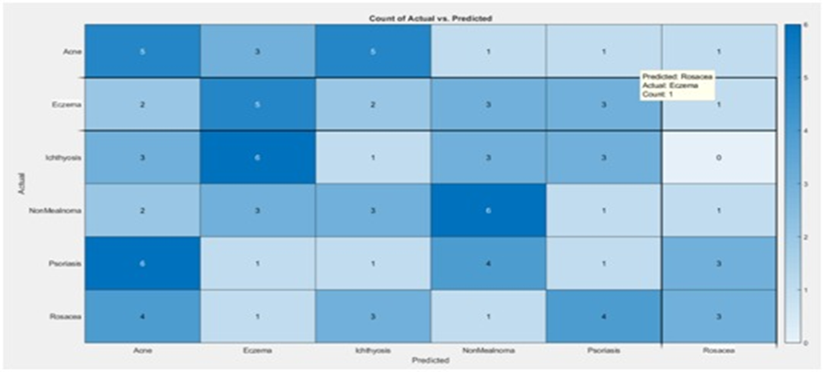
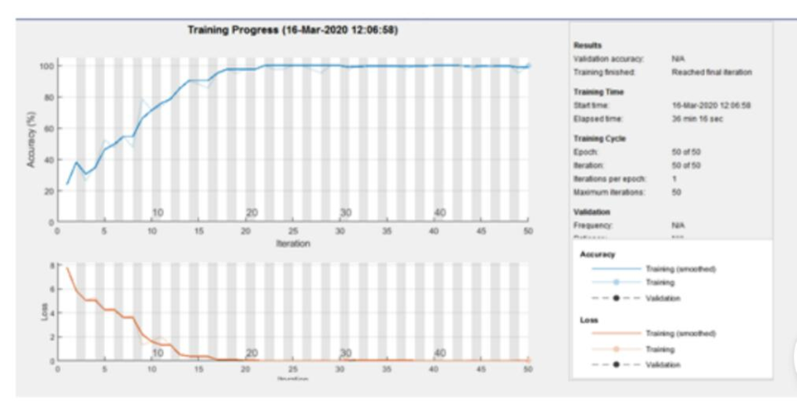

Slide 14
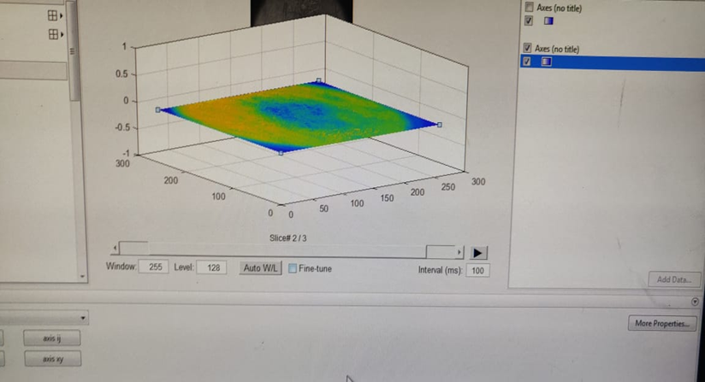

Slide 15
advantages
3D conversion for accuracy
Detection using n number of data sets
Remedy is provided after diagnosis

Slide 16
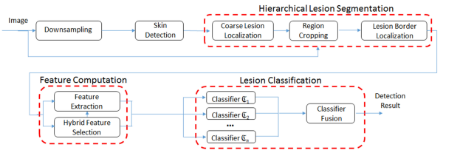
Architecture diagrams

Slide 17
CONCLUSION AND FUTURE ENHANCEMENT
In this report, we have made an attempt to reduce the error made by the dermatologists and help them with the diagnosis of certain skin diseases which are difficult to treat. By using the data present in the result of our test like the phases of the disease, what kind of disease it is, and the medications prescribed, the work of the physician is reduced to a great extent. We can also increase the number of diseases that could be diagnosed by our kit by increasing the no of input sample images given to that particular disease. In future, this kit can be enhanced or improved by using this image processing and central neural network technique in medical scanning equipment like X-ray machines, Magnetic Resource Imaging(MRI) scanner, Computerized Tomography(CT) scanner so that it can be used in identification and diagnosis of various diseases present in our human body.

Slide 18
References
Jufeng Yang, Xiaoxiao Sun, Jie Liang, Paul L. Rosin, Clinical Skin Lesion Diagnosis Using Representations Inspired by Dermatologist Criteria,2018.
Zulfikar Zulfikar and Zulhelmi Zulhelmi, Statistical Investigation of Skin Image for Disease Analyzing in Rural Area Using Matlab ,2017.
Kyamelia Roy Sheli,Sinha Chaudhuri Sanjana Ghosh, Swarna Kamal Dutta Proggya Chakraborty Rudradeep Sarkar, Skin Disease detection based on different segmentation Techniques ,2019.
Archana Ajith, Vrinda Goel, Priyanka Vazirani, Dr. M. Mani Roja,Digital dermatology-Skin disease detection model using image processing,2018.

Slide 19
D.N.V.S.L.S. Indira, JYOTSNA SUPRIYA, Detection and analysis of skin cancer using wavelet techniques,2011.
Nikos Petrellis, Using color signatures for the classification of skin diseases,2018.
Soniya Mane, Dr. Swati Shinde, A Method for Melanoma Skin Cancer Detection Using Dermoscopy Images, 2018.
Stepanka Barotova, Martin Drahansky, Fingerprint damage localizer and detector of skin diseases from Finger print images,2017.

Slide 20


